Slide 1
PROFESSIONAL SURVEYING
A CAREER WITHOUT BOUNDARIES
Notes:
Note to speaker: The script presented below is designed to give you a general idea of the points to cover during this presentation. Feel free to use it verbatim, or if you prefer to ad lib, let these notes serve as guide to keep you on track or as a launching point for expanding in greater detail. The text in italics provides an overview of a slide’s content and can function as stage directions as you move through the script.
Introduce yourself.
Hello, my name is ________, and I’m a (professional) surveyor. I’m here today to talk to you about the surveying profession.
Ask the audience about themselves. It’s a good time to gauge the room if you are unfamiliar with the group. You can ask:
Who here is thinking about attending college or a technical school?
Does anyone have an idea of what career field they want to enter?
Who is not sure what they want to do after high school?

Slide 2
INTRODUCTION
What is
Surveying?
Surveyors measure just about anything on the land, in the sky, or in the water. We depend on surveying to ensure order in the physical world around us, and it plays an integral role in land development—roads, cities, bridges, utilities— you name it. Surveyors help shape the future.
Notes:
Does anyone know what a surveyor does? What surveying is?
Let students give answers if any hands are raised.
The really boiled down version is this: Surveying is a branch of applied mathematics that is concerned with analyzing and recording the characteristics of a land span to help design, plan, map, or construct.
Surveyors measure just about anything on the land, in the sky, or in the water. We depend on surveying to ensure order in the physical world around us, and it plays an integral role in land development—roads, cities, bridges, utilities— you name it. Surveyors help shape the future.

Slide 3
Mapping the Future
"I chose surveying for my love of the outdoors. I wanted the hybrid mixture of working in the field and in the office. Plus, you can make a great living as a professional surveyor, far exceeding what I expected when I first got into surveying. It's lucrative.”
Brad Roberts, P.L.S.
Director of Gulf Survey Operations
Matrix New World Engineering
Notes:
What does a career as a surveyor look like? Are you always outside? Are you always in an office at a desk? For most, it’s a hybrid of outdoor and office work.

Slide 4
A Career
Surveying can be a rewarding career choice for those who enjoy the idea of working outdoors and in an office.
Notes:
Surveyors are not restricted to one work environment. Their work can take them outdoors to gather data/evidence or inside the office to analyze data.
Surveyors may perform research of land records, serve as an expert witness in the court room, or work with engineers, landowners, architects, attorneys, land developers, and realtors.
A career in surveying could bring you anywhere in the world, from valley floors to mountain peaks and every place in-between.

Slide 5
Notes:
This is a video on vimeo. If you have access to wifi, the video will play. IF you do not have access to wifi, skip this slide.

Slide 6
TYPES OF SURVEYORS
Construction Surveyor
Geodesist
Photogrammetrist and
Remote Sensing Analyst
Hydrographic Surveyor
Notes:
Not all surveyors do the same work. There is some overlap in the field, and some surveyors may specialize in one or a few of these areas of focus.
Construction Surveyor
Think about what we build: bridges, houses, skyscrapers, underground tunnels, pipelines, utility networks, refineries, shopping centers, and offshore oil rigs. The list is endless. Construction surveyors make measurements and recommendations to engineers, architects, and other professionals at all stages of construction projects.
Geodesist
These surveyors determine the size and shape of the Earth and the precise location of points on its surface. Geodesy is closely connected to astronomy and has been used to guide the old great sailing ships and today’s water traffic. With the creation of GPS, or global positioning systems, geodesists can tell the exact position of an object on the Earth’s surface.
Photogrammetrist and
Remote Sensing Analyst
These specialists gather information about a site without actually coming in contact with it. Aerial photography and satellite imagery are examples of data collected. These surveys are good for land inaccessible by foot or large areas that need to be surveyed quickly. For example, a photogrammetrist may be hired to track the movement of a pollutant in a large body of water after an environmental accident. —usually within a centimeter. Geodesists often work for the government in all areas of the country.
Hydrographic surveyors
Underwater topographic surveying is known as hydrography. This type of surveying is important when measuring erosion, guiding dredging projects, exploring for oil and rare mineral deposits, and marking underwater hazards. These surveyors use specialized equipment to gather data and draw maps of water features and the sea floor. Many clients depend on hydrographic surveyors, including the shipping industry, government researchers, oil companies, and utility networks.

Slide 7
TYPES OF SURVEYORS
Boundary Surveyor
Geographic Information
Systems (GIS) Analyst
Topographic Surveyor
Forensic Surveyor and
Expert Witness Specialist
Notes:
Boundary Surveyor
Boundary, or cadastral, surveyors measure, mark, and map the boundary lines of land ownership. These surveyors trace deeds and other public records to verify the measurements of a piece of property for which the original survey could date back hundreds of years.
Geographic Information
Systems Analyst
GIS analysts use high-tech computer software and hardware that stores, displays, analyzes, and maps information. The land survey is the first layer and provides the framework for additional data layers that give more detail. Additional layers could include a city’s traffic lights and fire hydrants, for example. Large companies, cities and towns, and commercial
developers use GIS studies to plan projects.
Topographic Surveyor
Topographic surveyors measure and map the shape, contour, and location of land features such as valleys, mountains, and man-made objects on the surface of the land and below bodies of water.
Forensic Surveyor and
Expert Witness Specialist
Federal, state, and local laws play a large part in surveyors’ careers. A licensed surveyor can clarify and add credibility to a court case about a property dispute or aspects of an industrial accident. Surveyors who build reputations as expert witnesses are in high demand. Being an expert witness requires extensive knowledge about a particular area of surveying and many years of experience.

Slide 8
FRONTIER OF TECHNOLOGY
Notes:
We’ve spoken about some of the fields of surveying and what surveyors do. To accomplish their work, surveyors use cutting-edge technology, every day, both in the office and in the field.

Slide 9
TECHNOLOGY IN THE FIELD
LiDAR
Light detection and ranging (LiDAR) is a remote sensing method used to examine the surface and features of the Earth. It uses lasers to measure variable distances and helps surveyors create maps more accurately, precisely, and flexibly.
Notes:
LiDAR (airborne and ground-based) | Light detection and ranging (LiDAR) is a remote sensing method used to examine the surface and features of the Earth. It uses lasers to measure variable distances and helps surveyors create maps more accurately, precisely, and flexibly.
These LiDAR scanners collect data points. Picture a light beam hitting off a surface and coming back to the scanner. That’s a data point. Some LiDAR scanners can collect over 2 million data points every second. Some can do full 360 scans of an area, with millions of data points, to create a 3D model, or a point cloud model, of an aera.
And there are mobile LiDAR scanners. For example, scanners can be attached to a vehicle, a drone, strapped to a person, or fixed on a moving robot.

Slide 10
TECHNOLOGY IN THE FIELD
Total Stations
Total stations are instruments that use electronic transits to measure angles and distances to determine the location and elevations of features.
Notes:
Total stations | A total station is a surveying instrument that uses electronic distance measurement (EDM) to measure distance and angles. Total stations are an extremely accurate tool for measuring distance. Most total stations can measure distances of up to 1.5 kilometers with an accuracy of 1.5 millimeters.
You may often see surveyors on constructions sites, or the side of the road with one of these instruments. Since it sits on a tripod, some people mistake them for cameras.

Slide 11
TECHNOLOGY IN THE FIELD
GNSS
Global navigation satellite system (GNSS) receivers use signals from satellites to collect position, velocity, and time information to accurately map and model the physical world. GPS is an example of a GNSS.
Notes:
GNSS | Global navigation satellite system (GNSS) receivers use signals from satellites to collect position, velocity, and time information to accurately map and model the physical world. GPS is an example of a GNSS.
And almost everyone has GPS on their phone. It’s useful, and accurate for giving directions when driving, or even using it for Geocaching in most cases.
The GNNS Systems that surveyors use is extremely accurate with real time data. Most units can give you the precise coordinates within fractions of an inch.

Slide 12
TECHNOLOGY IN THE FIELD
Drones
Total stations are instruments that use electronic transits to measure angles and distances to determine the location and elevations of features.
Notes:
UAS (drones) | UAS or unmanned aircraft systems are emerging tools for professional surveyors. UAS produce aerial maps that are used for progress monitoring and as-built surveys.
When a drone flies, it uses ground facing sensors with RGB cameras to capture images. Some drones even have LiDAR scanners to help collect information. When the drone surveys the lands, it will use the RGB camera to photograph the ground at different angles. Each angle is tagged with the exact coordinates.
The Drones can create 2D maps, 3d maps, 3D models, thermal maps, and more.

Slide 13
Surveying as a Career
“There’s a sense of adventure and mystery being a land surveyor, and that’s what drew me to the profession. I love the entire process of preparing a survey.”
Virginia Winberg, P.S.
Surveyor Project Manager
Notes:
Now that you know about surveying, what does a career look like?

Slide 14
SURVEYING AS A CAREER
Professionalism
Surveying is a profession. Joining the profession and becoming a P.S. instantly says you are a professional with experience.
Notes:
Being a professional surveyor or P.S. isn’t just a job. It is a career. You belong to a profession. You must be licensed to be a professional surveyor. And that’s something we’ll cover more in a little bit, but it can become the key to opening a lot of career doors.

Slide 15
SURVEYING AS A CAREER
Salary
Mean Salary for a Surveying Technician in 2023
0
$46,910
Mean Salary for a Surveyor in 2023
0
$71,060
Federal Government
Surveyor avg. in 2021
$89,364
0
Mean Salary for a Surveyor
Manager in 2023
0
$107,500
As a professional surveyor or P.S., you can expect to earn about 36 percent more than the average median salary. More-experienced surveyors earn higher salaries and those who own firms can easily earn six figures.
Notes:
Being a surveyor can be a lucrative career.
Here we have some data. The mean average for a surveying technician, which is usually someone with a two-year degree, or sometimes just a high school diploma, is about $47,000 a year according to the U.S. Bureau of Labor statistics.
The mean average for a surveyor, typically with and four-year degree is $71,060.
If that surveyor works for the federal government, say in the bureau of land management, on average, they make over $89,000 a year.
If a surveyor moves into a managing role, they make on average 107,500 a year.
And this is not rare. A lot of surveyors who open their own surveying firm can easily make over six figures every year.

Slide 16
SURVEYING AS A CAREER
Employment of professional surveyors is predicted grow in the coming years.
About 3,800 openings for surveyors are projected each year, on average, over the decade. Most of those openings are expected to result from the need to replace workers who exit the labor force, such as to retire.
Future
Outlook
Notes:
Employment of professional surveyors is predicted grow in the coming years.
About 3,800 openings for surveyors are projected each year, on average, over the decade. Most of those openings are expected to result from surveyors exiting the labor force, such as to retire.
The demand for surveyors is growing. And the workforce, or supply, is dwindling.

Slide 17
Pathway to the Profession
“You can go anywhere as a surveyor. I got an internship offer from Washington, D.C. Another one from Texas. There’s opportunities in super remote Alaska. That’s the coolest part about surveying.”
Colby Roberts
Freshman, Alfred State College
Notes:
It’s a good time to become a surveyor. Jobs are readily available.
I spoke about being a licensed professional surveyor before. Let’s come back to it. What’s the pathway?

Slide 18
Notes:
This is a video on vimeo. If you have access to wifi, the video will play. IF you do not have access to wifi, skip this slide.

Slide 19
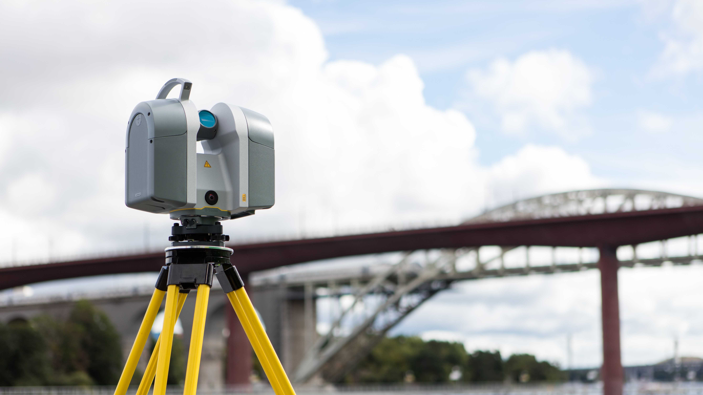
PATHWAY TO THE PROFESSION
Professional Surveying
Education
Most states require a four-year Bachelor's Degree in an accredited surveying program.
Beasurveyor.com to see list of schools
Notes:
First step is education. To become a professional surveyor, most states require a four-year bachelor’s degree in an accredited surveying program. Now there are some states that may only require an accredited two-year degree. And if you are more interested in being a surveying technician and not a professional surveyor, that might be all you need.
You can go to Beasurveyor.com or NSPS website to see list of schools, that have four-year and two-year programs.

Slide 20
Exams
To become a professional surveyor, you need to pass two licensing exams.
The Fundamentals of Surveying (FS) Exam
The Principals and Practice of Surveying (PS) Exam.
Experience
Most states require four years of progressive work experience.
Notes:
Next step are the exams. Just like how a doctoral candidate must pass the medical licensing exam to become a licensed practitioner, or a law student must pass the BAR exam to become a practicing lawyer, surveyors must pass two licensing exams. Those exams are the Fundamentals of Surveying Exam and the Principals and Practice of Surveying exam.
Typically, you take the fundamentals exam around college graduation and then you take the Principals and Practice exam after about four years of experience in the field.
And the last step is experience. And this is being on the job in a surveying capacity that shows progressive experience. Most states typically require four years of experience.
After you take these steps, you will become a licensed professional surveyor.

Slide 21
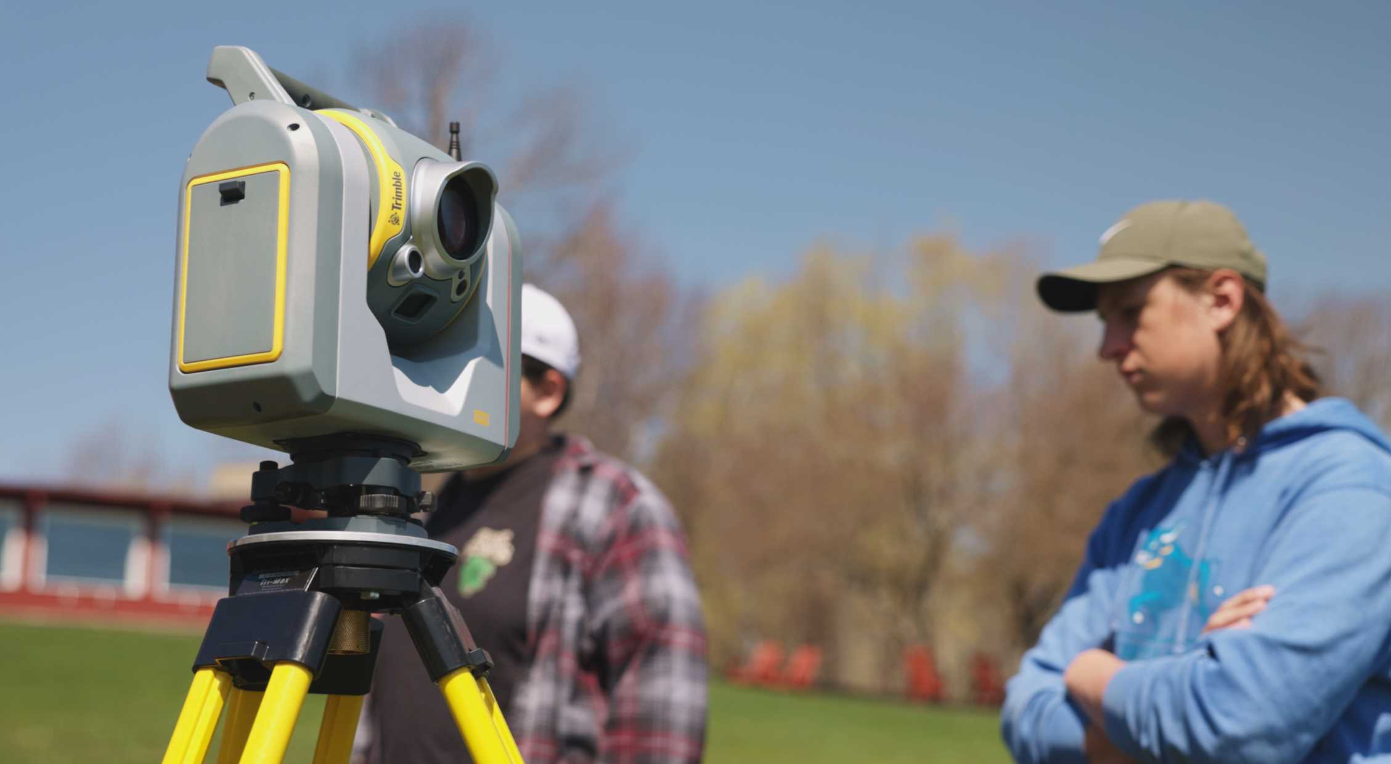
SURVEYING AS
A CAREER
Notes:
Questions?

